Slide 1



OVERVIEW OF THE HANDBOOK ON THE FINANCIAL TRANSACTIONS OF THE SANGGUNIANG KABATAAN (HFTSK)
As presented by:
Atty. Roland Café Pondoc, CPA,
MBA, REB, REA, Lt. Col. PAF (Res.)
PICPA National President
Former COA Commissioner
March 27, 2025
PHALGA Summit
Laoag City

Slide 2





Legal Basis
Section 2(2), Article IX-D of the 1987 Philippine Constitution
Section 21 of the Implementing Rules and Regulations (IRR) of Republic Act (RA) No. 10742, otherwise known as the “SK Reform Act of 2015”

Slide 3

RA No. 10742

Slide 4


Background Information of IRR of RA No. 10742
Who are considered
as YOUTH?
Core Youth
(18-24)
Sec. 3(n), IRR of RA 10742
Child Youth
(15-17)
Adult Youth
(25-30)

Slide 5
Background Information of IRR of RA No. 10742
Youth ages 15-30
Katipunan
ng Kabataan (KK)
6 months residency
Sec. 4, IRR of RA 10742
Duly registered voters

Slide 6
Background Information of IRR of RA No. 10742
Elect SK chairperson and 7 members
Highest policy-making body to decide on youth matters in the barangay
Powers and Functions
of the KK
Sec. 5, IRR of RA 10742
KK concurrence required on CBYDP and ABYIP

Slide 7
Background Information of IRR of RA No. 10742
Formulate the CBYDP and ABYIP
Powers and Functions
of the SK
Approve the annual and supplemental SK budget
Sec. 8, IRR of RA 10742
Promulgate resolutions for SK objectives

Slide 8
Background Information of IRR of RA No. 10742
Initiate and implement youth programs and projects
Powers and Functions
of the SK
Hold fund-raising activities in line with the CBYDP
Sec. 8, IRR of RA 10742
Create regular or special committees

Slide 9
Background Information of IRR of RA No. 10742
Submit the annual and end-of-term program accomplishments and financial reports to the Sangguniang Barangay, present the same to the KK assembly copy furnished LGOO, LYDC, COA and NYC
Partner with LYDC in planning and executing programs and projects for the youth
Conduct youth profiling, establish, maintain and update youth database and ensure proper turnover to next set of officers
Submit the annual and end-of-term program accomplishments and financial reports to the Sangguniang Barangay, present the same to the KK assembly copy furnished LGOO, LYDC, COA and NYC
Partner with LYDC in planning and executing programs and projects for the youth
Powers and Functions
of the SK
Sec. 8, IRR of RA 10742

Slide 10
Background Information of IRR of RA No. 10742
Assist in the establishment and registration of youth organizations and youth serving organizations in the barangay
Adopt and implement a policy of full public disclosure of all transactions and documents involving public interest.
Authorize the SK Chairperson to enter into contracts on behalf of the SK, subject to RA 10742, RA 7160 and RA 9184
Powers and Functions
of the SK
Sec. 8, IRR of RA 10742

Slide 11
Background Information of IRR of RA No. 10742
Comply with the bonding requirements
Powers and Functions
of the SK
Exercise other powers and perform other functions prescribed by law or ordinance, or delegated by Sangguniang Barangay or NYC
Sec. 8, IRR of RA 10742

Slide 12


Definition of Terms
Basic Standards and Policies
Specific Policies
Narrative Procedures and Procedural Flowcharts
Accounting Plan
Content of the HFTSK

Slide 13
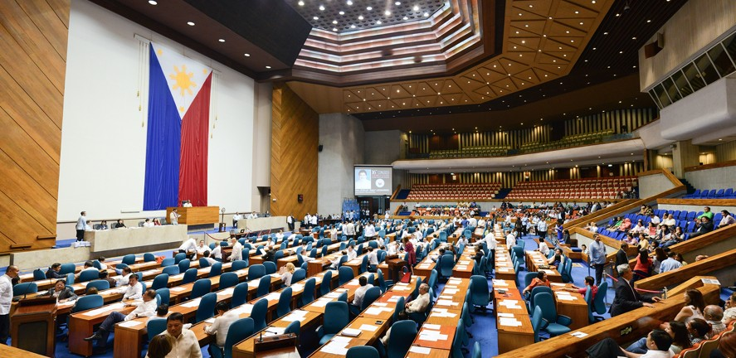



DBM–DILG–NYC
Joint Memorandum Circular
(JMC) No. 1
January 23, 2019

Slide 14



JMC No. 1
Appropriation of the SK Funds
Release of the SK Funds
Planning and Budgeting process for the SK Funds
General Guidelines
Comprehensive Barangay Youth Development Plan (CBYDP)
Annual Barangay Youth Development Investment Program (ABYIP)
Appropriation of the SK Funds
Budget Preparation
Budget Authorization
Budget Review
Accountability Reports
Budget Execution

Slide 15
JMC No. 1
Cases
for
Resolution
Cases not covered by the JMC shall be referred to the NYC for joint resolution by the DBM, NYC and DILG

Slide 16
Definition of Terms
Basic Standards and Policies
Specific Policies
Narrative Procedures and Procedural Flowcharts
Accounting Plan

Slide 17







Annual Budget
Approved Budget
Commitments
Definition of Terms
Disbursements/
Payments
Fair Value
SK Funds

Slide 18






Property and Equipment
Receipts/ Collections
Reporting Period
Definition of Terms
Semi-expendable Property
Supplemental Budget
Supplies and Materials

Slide 19


Basic Standards and Policies
SK operations
Financial Independence in:
Disbursements and encashment of its funds, income and expenditures
SK funds deposited in the name of the SK in GOB/AGDB with the SK chairperson and SK treasurer as signatories

Slide 20

Basic Standards and Policies
10% of barangay fund shall be set aside for the SK
10%
The sangguniang barangay shall appropriate the SK fund in lump sum

Slide 21
Basic Standards and Policies
SK fund automatically released, not subject to any lien or holdback
10%
10% SK share from the barangay released to SK not later than 5 working days from receipt of the IRA by the barangay

Slide 22
Basic Standards and Policies
SK funds are deposited in the current account of the SK not later than 5 WDs after the crediting of the monthly IRA share of the barangay
10%
All monies officially received by the SK officials in any capacity or on any occasion shall be accounted as SK Fund, unless otherwise provided by law

Slide 23


Basic Standards and Policies
10% of the GF of the barangay
SK Funds consist of:
proceeds from fund-raising activities aligned with CBYDP and ABYIP
contributions, monies and all other resources received without specific purposes
funds received for specific purposes

Slide 24
utilized in accordance with the approved budget of the SK
SK Funds shall be:
allocated in an annual budget, and if funds allow, in a supplemental budget in accordance with the adopted ABYIP
(Section 20c of the IRR of RA 10742)

Slide 25


Equitable access to Quality Education
Utilization of SK Funds for Youth Development and Empowerment Purposes
Environmental Protection
Climate Change Adaptation
Disaster Risk Reduction and Resiliency
Youth Employment and Livelihood
Health and Anti-drug Abuse
Gender Sensitivity
Sports Development
(Section 20a and 20c of the IRR of RA 10742)
Capability Building which emphasizes leadership training

Slide 26




Basic Standards and Policies
RA 10742 and its IRR
SK Funds Disburse pursuant to:
RA 7160
(Section 20, IRR of RA 10742)
RA 9184
Other pertinent laws, rules and regulations

Slide 27

Basic Standards and Policies
All revenues/receipts shall at all times be properly acknowledged by an Official Receipt
Disbursements/payments or disposition of the SK funds or property shall bear the approval of the proper officials
All claims/disbursements shall be supported with complete documentation

Slide 28



Basic Standards and Policies
SK chairperson shall be immediately and primarily responsible for all the funds and property pertaining to the SK
SK treasurer shall be responsible in the proper handling or custody of the funds and property of the SK

Slide 29
Basic Standards and Policies
The SK chairperson with the concurrence of the majority of all the SK members shall designate a Budget Monitoring Officer (BMO) who shall be responsible in monitoring the SK budget and preparation of budget reports. The BMO shall come from the SK officials except the SK treasurer

Slide 30
Basic Standards and Policies
Fiscal responsibility is shared by all those exercising authority over the financial affairs, transactions and operations of the SK

Slide 31
Basic Standards and Policies
Persons entrusted with the possession or custody of the funds and property shall be immediately responsible to the SK chairperson w/o prejudice to the liability of either party to the SK

Slide 32
Basic Standards and Policies
Every officer of the SK whose duties permit or require the possession or custody of gov’t funds or property shall be accountable therefor and for the safekeeping thereof in conformity with law

Slide 33

Basic Standards and Policies
Every Accountable Officer shall be properly bonded in accordance with law:
Sec. 101, PD 1445
EO No. 292
Treasury Circular No. 02-2009 dated August 6, 2009
Other pertinent issuances of the BTr

Slide 34


Basic Standards and Policies
SK financial transactions shall be kept under cash basis of accounting using a single-entry bookkeeping system and recorded in accordance with the list of accounts provided in the HFTSK

Slide 35

Basic Standards and Policies
Non-cash transactions are reported in the Notes to FS
Cash
Basis
records transactions and events only when cash is received or paid

Slide 36
Basic Standards and Policies
focus is on cash liquidity
Cash
Basis
FS provide readers with information about the sources of cash received, the purposes for which the cash was used and the cash balance

Slide 37





SK Transaction Areas
Budget
Receipts/ Collections
Disbursements/
Payments
Supplies and Materials
Property and Equipment
Financial Statements and Other Reports

Slide 38


Budget
Who is the SK’s Budget Officer?
Registry of Budget, Commitments, Payments and Balances (RBCPB)
Registry of Specific Purpose Fund, Commitments, Payments and Balances (RSPFCPB)
Summary of Budget, Commitments, Payments and Balances (SBCPB)
Summary Specific Purpose Fund, Commitments, Payments and Balances (SSPFCPB)
Statement of Comparison of Budget and Actual Amounts (SCBAA)

Slide 39


Receipts/Collections and Deposits
Who is the SK’s Collecting Officer?
Register of Cash Receipts, Deposits and Other Related Financial Transactions (RCRD)
Register of Cash in Bank and Other Related Financial Transactions (RCB)
Statement of Receipts and Payments (SRP)

Slide 40


Disbursements/Payments
Who is the SK’s Disbursing Officer?
Disbursement Voucher
Check payment
Register of Cash in Bank and Other Related Financial Transactions (RCB)

Slide 41


Supplies and Materials
Supplies and Materials/Semi-expendable Property
Who is the SK’s Supply Officer?
RA No. 9184
What committees are created?
What records are maintained?

Slide 42


Property and Equipment
Tangible property of P15,000 and up
Who is the SK’s Property Officer?
RA No. 9184
What records are maintained?

Slide 43


Financial Statements and Other Reports
Statement of Receipts and Payments (SRP)
Statement of Comparison of Budget and Actual Amounts (SCBAA)
Notes to Financial Statements
Report on Inventory of Purchased Supplies and Materials (RIPSM) /
Report on Inventory of Donated Supplies and Materials (RIDSM)

Slide 44
Financial Statements and Other Reports
Report on Inventory of Purchased Property & Equipment (RIPPE) /
Report on Inventory of Donated Property & Equipment (RIDPE)
Summary of Budget, Commitments, Payments and Balances (SBCPB)
Summary of Special Purpose Fund, Commitments, Payments and Balances (SSPFCPB)
Bank Reconciliation Statement (BRS)
Registry of Accountability for Accountable Forms (RAAF)

Slide 45

All accountable forms, records, registers, registries, DVs and SDs, and reports of SK shall be made available for audit by the COA Auditor concerned

Slide 46

Accounting Plan for the SK Financial Transactions

Slide 47
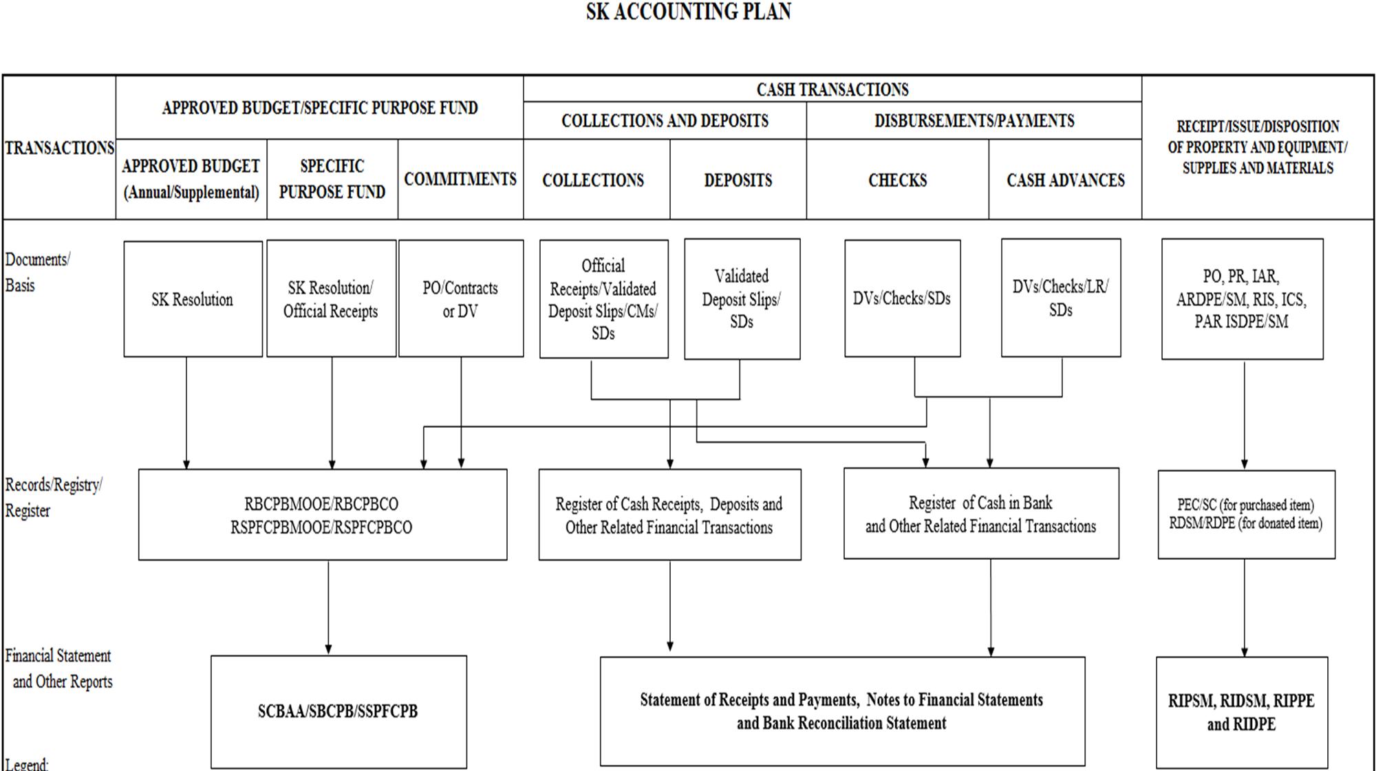

Slide 48
Budget
Annual Budget/ Supplemental Budget
Funds Received for Specific Purpose
Commitments
Disbursement/
Payment
Documents/ Basis
SK Resolution and Copy of the Approved Budget
SK Resolution and Copy of OR
PO/Contract/DV
Paid DV/SDs
Registry
Registry of Budget, Commitments, Payments and Balances (RBCPB)
Registry of Specific Purpose Fund, Commitments, Payments and Balances (RSPFCPB)
FS and Other Reports
Summary of Budget, Commitments, Payments and Balances (SBCPB)
Summary of Specific Purpose Fund, Commitments, Payments and Balances (SSPFCPB)
Statement of Comparison of Budget and Actual Amounts (SCBAA)

Slide 49
Collections and Deposits
COLLECTIONS
DEPOSITS
Documents/Basis
ORs/VDSs/CMs/SDs
VDSs/SDs
Records/Registry/ Register
Register of Cash Receipts, Deposits and Other Related Financial Transactions (RCRD)
Register of Cash in Bank and Other Related Financial Transactions (RCB)
FS and Other Reports
Statement of Receipts and Payments (SRP)
Notes to Financial Statements
Bank Reconciliation Statement

Slide 50
Disbursements/Payments
CHECKS
CASH ADVANCES
Documents/ Basis
DVs/Checks/SDs
DVs/Checks/LR/SDs
Registry/ Register
RBCPB/RSPFCPB
Register of Cash in Bank and Other Related Financial Transactions (RCB)
FS and Other Reports
SCBAA/SBCPB/ SSPFCPB
Statement of Receipts and Payments (SRP)
Notes to Financial Statements
Bank Reconciliation Statement

Slide 51
Receipt/Issue/Disposition Of Property and Equipment/Supplies and Materials
Documents/Basis
PO, PR, IAR, ARDPE/SM,
RIS, ICS, PAR ISDPE/SM
Records/Registry/ Register
PEC/SC (for purchased item)
RDSM/RDPE (for donated item)
FS and Other Reports
RIPSM, RIDSM, RIPPE and RIDPE

Slide 52

THANK YOU!

